Slide 1


INDIAN INSTITUTE OF TECHNOLOGY KHARAGPUR
Department of Electronics & Electrical Communication Engineering
SNAP - FPGA
DESIGN LAB
Group Number: 02 Jeevan | Durga Prasad | Vamshikrishna | Sai Kavya
Supervisor:
Prof. Aniket Singha

Slide 2
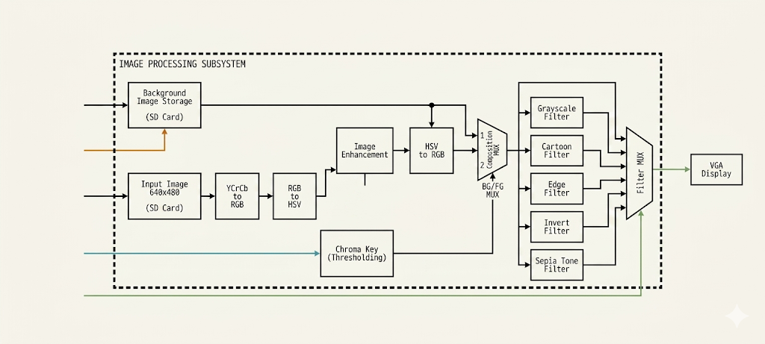
BLOCK DIAGRAM

Slide 3
STAGE - 01: BACKGROUND ADDITION

Slide 4
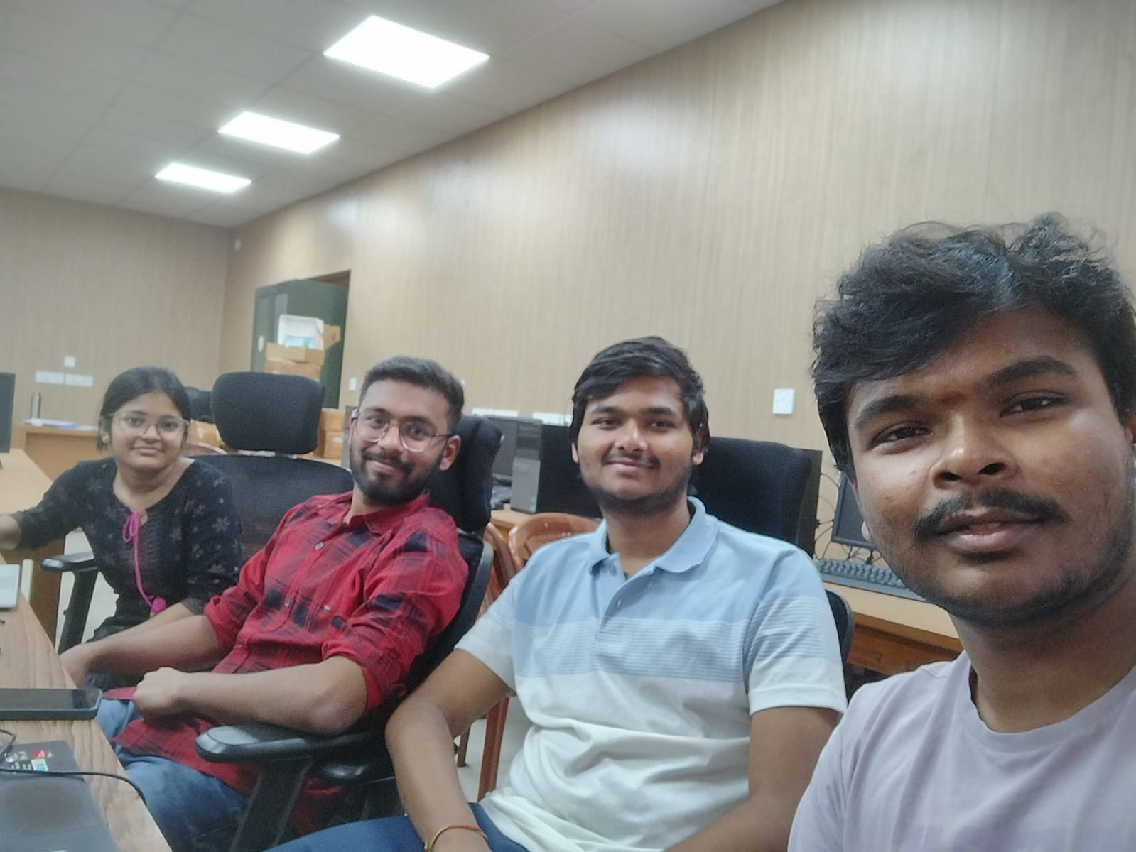
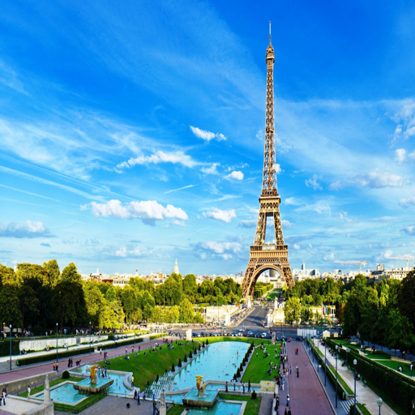
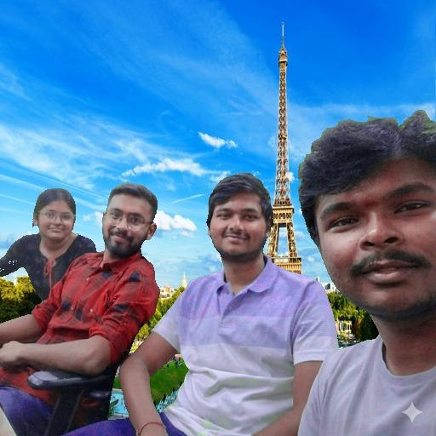
BACKGROUND ADDITION

Slide 5
STAGE - 02 : FILTERS AND EQUATIONS
SW[0]
filters_en
Enable Stage 2
SW[1]
enhance_en
HSV brightness
SW[3:2]=00
SEPIA
Warm matrix
SW[3:2]=01
INVERT
255−channel
SW[3:2]=10
EDGE
Sobel gradient
SW[3:2]=11
CARTOON
Gauss + Sobel
SEPIA (SW[3:2]=00)
INVERT (SW[3:2]=01)
Rout = 0.393R + 0.769G + 0.189B
Gout = 0.349R + 0.686G + 0.168B
Bout = 0.272R + 0.534G + 0.131B
R′ = 255 − R
G′ = 255 − G
B′ = 255 − B
EDGE — Sobel (SW[3:2]=10)
CARTOON = Gaussian + Sobel (SW[3:2]=11)
Gx=(a2+2a3+a4)−(a0+2a7+a6)
Gy=(a0+2a1+a2)−(a6+2a5+a4)
grad=|Gx|+|Gy| thr=50 → binary
Kernel: 1 2 1 / 2 4 2 / 1 2 1 (÷16)
Sobel edge>100 → black outline overlay

Slide 6
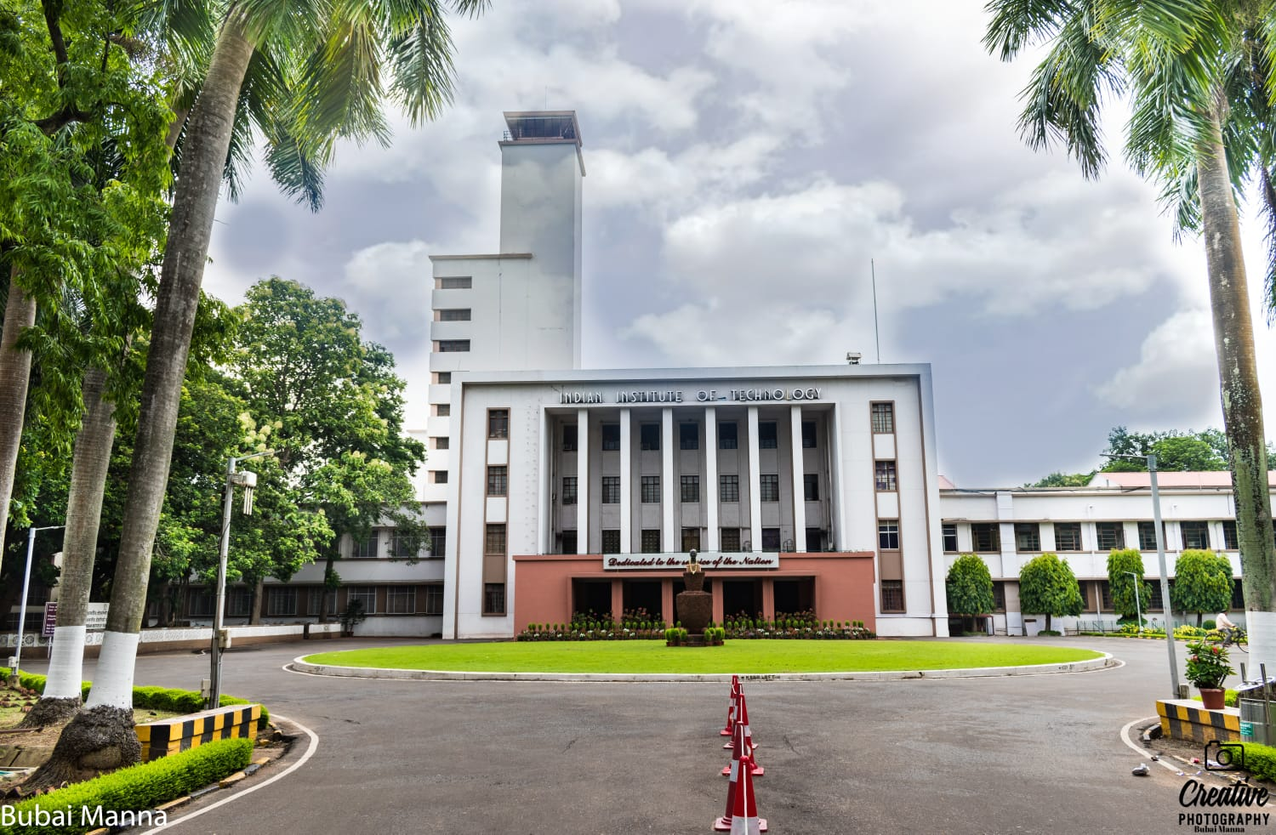
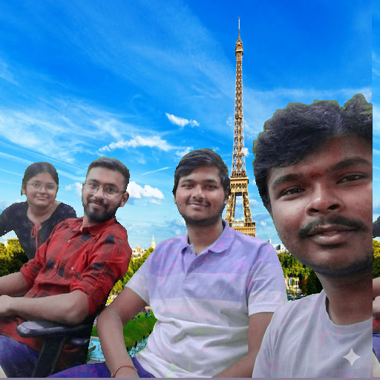
WITHOUT FILTER

Slide 7
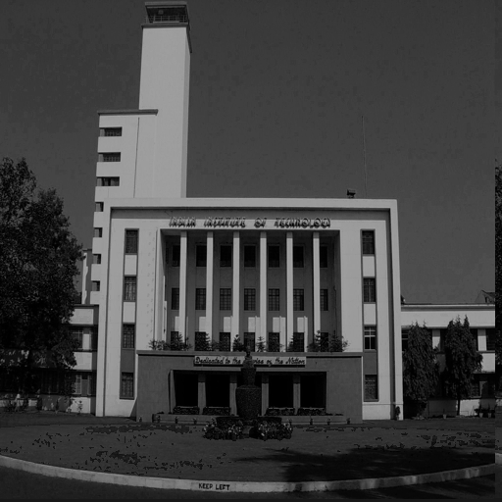
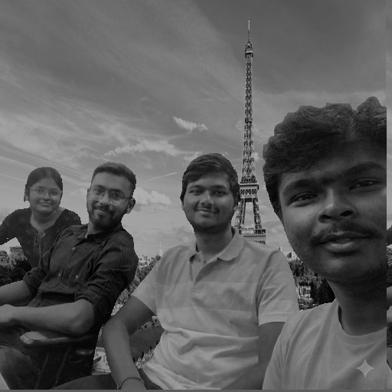
GREY SCALE FILTER

Slide 8
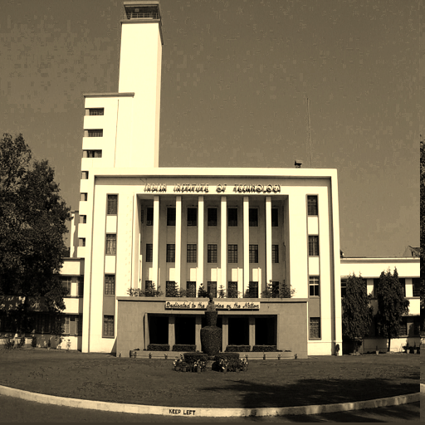
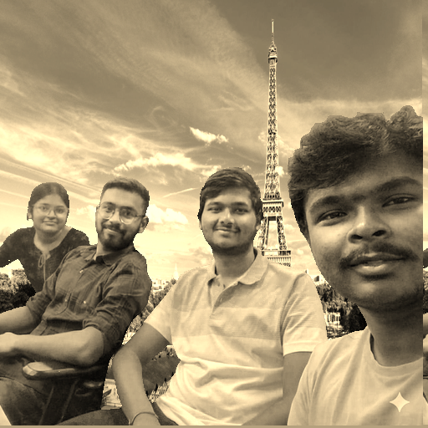
SEPIA FILTER

Slide 9
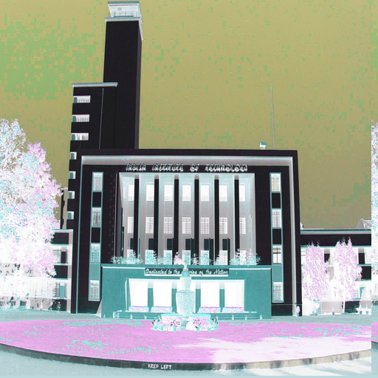
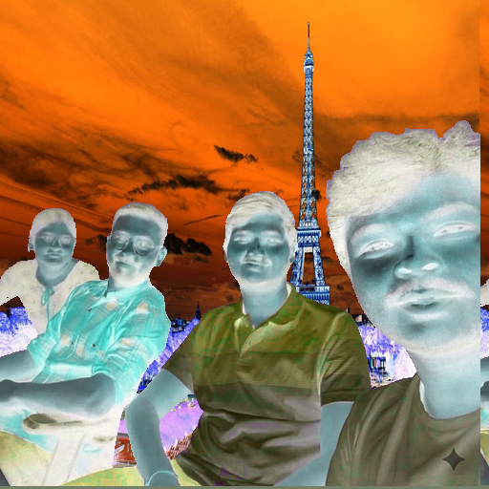
INVERT FILTER

Slide 10
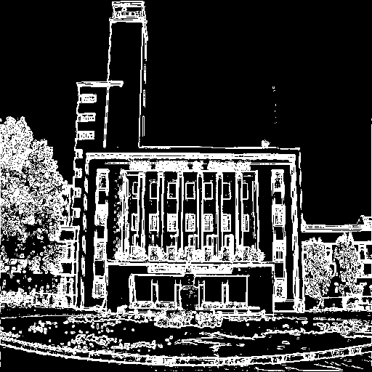
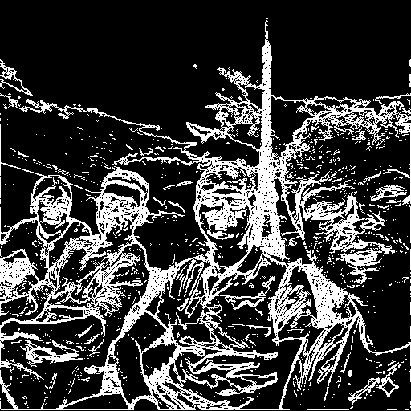
EDGE DETECTION FILTER

Slide 11
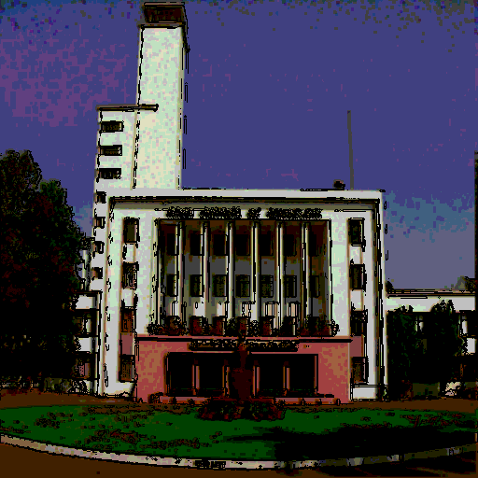
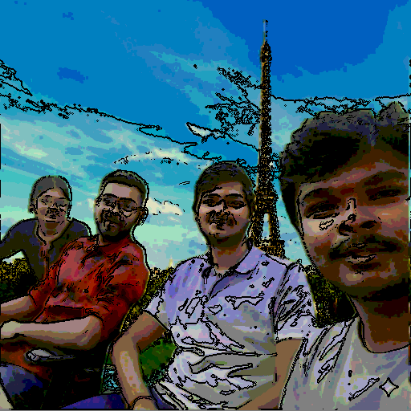
CARTOON FILTER

